Slide 1
Mathematics for AI
Adams Wai Kin Kong
School of Computer Science and Engineering
Nanyang Technological University, Singapore
adamskong@ntu.edu.sg
Copyright © Cengage Learning. All rights reserved.

Slide 2
Vector Spaces and Subspaces

Slide 3
Vector Spaces and Subspaces (1 of 4)
Definition
Let V be a set on which two operations, called addition and scalar multiplication, have been defined. If u and v are in V, the sum of u and v is denoted by u + v, and if c is a scalar, the scalar multiple of u by c is denoted by cu.
If the following axioms hold for all u, v, and w in V and for all scalars c and d, then V is called a vector space and its elements are called vectors.

Slide 4
Vector Spaces and Subspaces (2 of 4)
1. u + v is in V. Closure under addition
2. u + v = v + u Commutativity
3. (u + v) + w = u + (v + w) Associativity
4. There exists an element 0 in V, called a zero vector, such that u + 0 = u.
5. For each u in V, there is an element −u in V such that u + (−u) = 0.

Slide 5
Vector Spaces and Subspaces (3 of 4)
6. cu is in V. Closure under scalar multiplication
7. c(u + v) = cu + cv Distributivity
8. (c + d)u = cu + du Distributivity
9. c(du) = (cd)u
10. 1u = u.

Slide 6

Example 6.3 (1 of 3)
Let ℘₂ denote the set of all polynomials of degree 2 or less with real coefficients. Define addition and scalar multiplication in the usual way. If
are in ℘₂, then
has degree at most 2 and so is in ℘₂ If c is a scalar, then
is also in ℘₂. This verifies axioms 1 and 6.

Slide 7


Example 6.3 (2 of 3)
The zero vector 0 is the zero polynomial—that is, the polynomial all of whose coefficients are zero. The negative of a polynomial
is the polynomial
It is now easy to verify the remaining axioms. We will check axiom 2 and leave the others for Exercise.

Slide 8
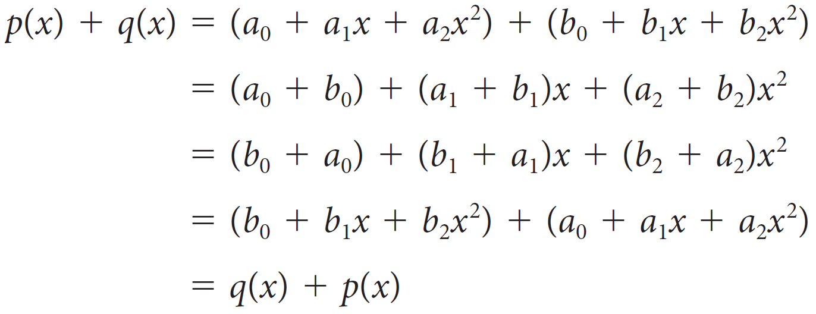
Example 6.3 (3 of 3)
With p(x) and q(x) as above, we have
where the third equality follows from the fact that addition of real numbers is commutative.

Slide 9
Vector Spaces and Subspaces (4 of 4)
Theorem 6.1
Let V be a vector space, u a vector in V, and c a scalar.
a. 0u = 0
b. c0 = 0
c. (− 1)u = −u
d. If cu = 0, then c = 0 or u = 0.

Slide 10
Subspaces

Slide 11
Subspaces (1 of 3)
Definition
A subset W of a vector space V is called a subspace of V if W is itself a vector space with the same scalars, addition, and scalar multiplication as V.

Slide 12
Subspaces (2 of 3)
Theorem 6.2
Let V be a vector space and let W be a nonempty subset of V. Then W is a subspace of V if and only if the following conditions hold:
a. If u and v are in W, then u + v is in W.
b. If u is in W and c is a scalar, then cu is in W.

Slide 13
Example 6.14
If V is a vector space, then V is clearly a subspace of itself. The set {0}, consisting of only the zero vector, is also a subspace of V, called the zero subspace.
To show this, we simply note that the two closure conditions of Theorem 6.2 are satisfied:
0 + 0 = 0 and c0 = 0 for any scalar c
The subspaces {0} and V are called the trivial subspaces of V.

Slide 14
Subspaces (3 of 3)
If W is a subspace of a vector space V, then W contains the zero vector 0 of V.

Slide 15
Spanning Sets

Slide 16
Spanning Sets (1 of 2)
Definition
If S = {v₁, v₂, ... , v_{k}} is a set of vectors in a vector space V, then the set of all linear combinations of v₁, v₂, ... , v_{k} is called the span of v₁, v₂, ... , v_{k} and is denoted by span(v₁, v₂, ... , v_{k}) or span(S).
If V = span(S), then S is called a spanning set for V and V is said to be spanned by S.

Slide 17

Example 6.19
is in span (p(x), q(x)), where
In ℘₂, determine whether
Solution:
We are looking for scalars c and d such that cp(x) + dq(x) = r(x). This means that

Slide 18
Example 6.19 – Solution
Regrouping according powers of x, we have
Equating the coefficients of like powers of x gives
c + 2d = 1
−c + d = −4
c − 3d = 6
Which is easily solved to give c = 3 and d = −1. Therefore, r(x) = 3p(x) − q(x), so r(x) is in span(p(x), q(x)).

Slide 19
Spanning Sets (2 of 2)
Theorem 6.3
Let v₁, v₂, ... , v_{k} be vectors in a vector space V.
a. span(v₁, v₂, ... , v_{k}) is a subspace of V.
b. span(v₁, v₂, ... , v_{k}) is the smallest subspace of V that contains v₁, v₂, ... , v_{k}.

Slide 20
Linear Independence

Slide 21
Linear Independence (1 of 3)
Definition
A set of vectors {v₁, v₂, ... , v_{k}} in a vector space V is linearly dependent if there are scalars c₁, c₂, ... , c_{k}, at least one of which is not zero, such that
c₁v₁ + c₂v₂ + ... + c_{k}v_{k} = 0
A set of vectors that is not linearly dependent is said to be linearly independent.

Slide 22
Linear Independence (2 of 3)
Theorem 6.4
A set of vectors {v₁, v₂, ... , v_{k}} in a vector space V is linearly dependent if and only if at least one of the vectors can be expressed as a linear combination of the others.

Slide 23


Example 6.25
is linearly independent in ℘_{n}.
Solution 1:
Suppose that c₀, c₁, ... , c_{n} are scalars such that
Show that the set
Then the polynomial
is zero for all values of x. But a polynomial of degree at most n cannot have more than n zeros.

Slide 24


Example 6.25 – Solution 2 (1 of 2)
So p(x) must be the zero polynomial, meaning that c₀ = c₁ = c₂ = ... = c_{n} = 0.
Therefore,
is linearly independent.
Solution 2:
We begin, as in the first solution, by assuming that
Since this is true for all x, we can substitute x = 0 to obtain c₀ = 0. This leaves

Slide 25



Example 6.25 – Solution 2 (2 of 2)
Taking derivatives, we obtain
and setting x = 0, we see that c₁ = 0. Differentiating
and setting x = 0, we find that 2c₂ = 0, so c₂ = 0.
Continuing in this fashion, we find that
for k = 0, ... , n. Therefore, c₀ = c₁ = c₂ = ... = c_{n} = 0,
is linearly independent.

Slide 26
Linear Independence (3 of 3)
A set S of vectors in a vector space V is linearly dependent if it contains finitely many linearly dependent vectors. A set of vectors that is not linearly dependent is said to be linearly independent.

Slide 27
Bases

Slide 28
Bases (1 of 1)
Definition
A subset ℬ of a vector space V is a basis for V if
1. ℬ spans V and
2. ℬ is linearly independent.

Slide 29

Example 6.32
is a basis for ℘₂.
Solution:
First to show that the ℬ is linearly independent, in ℘₂. Let c₁, c₂, and c₃ be scalars such that
Show that
Then

Slide 30

Example 6.32 – Solution (1 of 3)
This implies that
c₁ + c₃ = 0
c₁ + c₂ = 0
c₂ + c₃ = 0
the solution to which is c₁ = c₂ = c₃ = 0. It follows that
is linearly independent.

Slide 31

Example 6.32 – Solution (2 of 3)
Now to show that the
be an arbitrary polynomial in ℘₂. We must show that there are scalars c₁, c₂, and c₃ such that
or, equivalently,

Slide 32
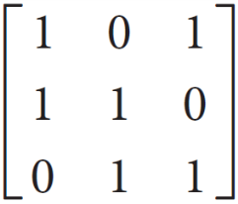
Example 6.32 – Solution (3 of 3)
Equating coefficients of like powers of x, we obtain the linear system
c₁ + c₃ = a
c₁ + c₂ = b
c₂ + c₃ = c
which has a solution, since the coefficient matrix
has rank 3 and, hence, is invertible. Therefore, ℬ is a basis for ℘₂.

Slide 33
Coordinates

Slide 34
Coordinates (1 of 4)
Theorem 6.5
Let V be a vector space and let ℬ be a basis for V. For every vector v in V, there is exactly one way to write v as a linear combination of the basis vectors in ℬ.

Slide 35

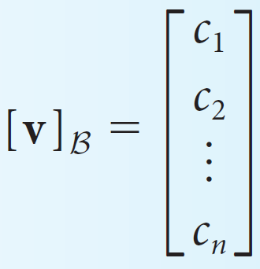
Coordinates (2 of 4)
Definition
Let
be a basis for a vector space V. Let v be a vector in V, and write v = c₁v₁ + c₂v₂ + ... + c_{n}v_{n}. Then c₁, c₂, ... , c_{n} are called the coordinates of v with respect to ℬ, and the column vector
is called the coordinate vector of v with respect to ℬ.

Slide 36


Example 6.37
Find the coordinate vector
with respect to the basis
Solution:
We need to find c₁, c₂, and c₃ such that
or, equivalently,

Slide 37
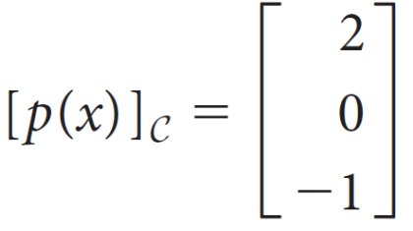

Example 6.37 – Solution
As in Example 6.32, this means we need to solve the system
c₁ + c₃ = 1
c₁ + c₂ = 2
c₂ + c₃ = −1
whose solution is found to be c₁ = 2, c₂ = 0, c₃ = −1. Therefore,
it is easy to check that it is correct.
Since this result says that

Slide 38

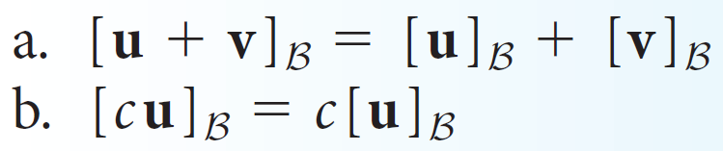
Coordinates (3 of 4)
Theorem 6.6
Let
be a basis for a vector space V. Let u and v be vectors in V and let c be a scalar. Then

Slide 39
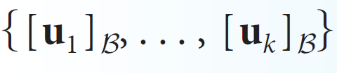

Coordinates (4 of 4)
Theorem 6.7
Let
be a basis for a vector space V and let u₁, ... , u_{k} be vectors in V. Then {u₁, ... , u_{k}} is linearly independent in V if and only if
is linearly independent in

Slide 40
Dimension

Slide 41
Dimension (1 of 5)
Theorem 6.8
Let
be a basis for a vector space V.
a. Any set of more than n vectors in V must be linearly dependent.
b. Any set of fewer than n vectors in V cannot span V.

Slide 42
Dimension (2 of 5)
Definition
A vector space V is called finite-dimensional if it has a basis consisting of finitely many vectors. The dimension of V, denoted by dim V, is the number of vectors in a basis for V.
The dimension of the zero vector space {0} is defined to be zero. A vector space that has no finite basis is called infinite-dimensional.

Slide 43
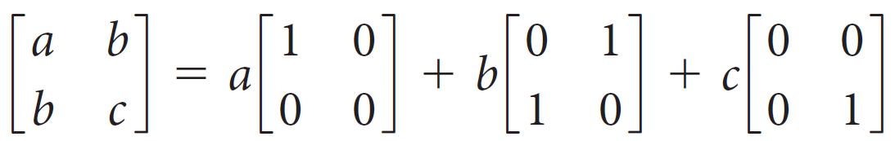
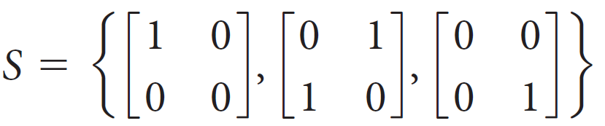
Example 6.42
Find the dimension of the vector space W of symmetric 2 × 2 matrices
Solution:
A symmetric 2 × 2 matrix is of the form
so W is spanned by the set

Slide 44
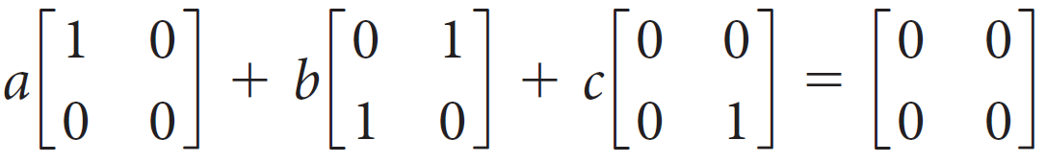
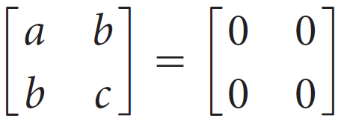
Example 6.42 – Solution
If S is linearly independent, then it will be a basis for W. Setting
we obtain
from which it immediately follows that a = b = c = 0. Hence, S is linearly independent and is, therefore, a basis for W. We conclude that dim W = 3.

Slide 45
Dimension (3 of 5)
Theorem 6.10
Let V be a vector space with dim V = n. Then:
Any linearly independent set in V contains at most n vectors.
Any spanning set for V contains at least n vectors.
Any linearly independent set of exactly n vectors in V is a basis for V.
Any spanning set for V consisting of exactly n vectors is a basis for V.
Any linearly independent set in V can be extended to a basis for V.
Any spanning set for V can be reduced to a basis for V.

Slide 46
Dimension (5 of 5)
Theorem 6.11
Let W be a subspace of a finite-dimensional vector space V. Then:
a. W is finite-dimensional and dim W ≤ dim V.
b. dim W = dim V if and only if W = V.

Slide 47
Change-of-Basis Matrices

Slide 48






Change-of-Basis Matrices (1 of 2)
Definition
Let ℬ = {u₁, ..., u_{n}} and
be bases for a vector space V. The n × n matrix whose columns are the coordinate vectors
of the vectors in ℬ with respect to
is denoted by
and is called the change-of-basis matrix from ℬ to
That is,

Slide 49






Change-of-Basis Matrices (2 of 2)
Theorem 6.12
Let ℬ = {u₁, ..., u_{n}} and
be bases for a vector space V and let
be the change-of-basis matrix from ℬ to
Then
for all x in V.
b.
is the unique matrix P with the property that
for all x in V.
c.
is invertible and

Slide 50







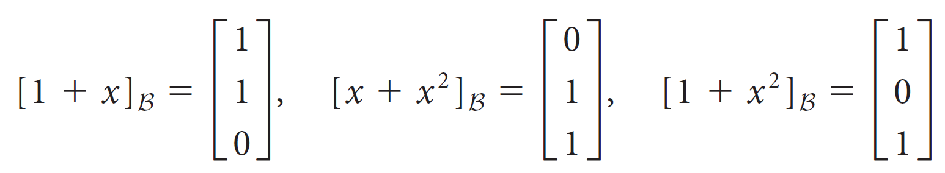
Example 6.46
for the bases ℬ =
Find the change-of-basis matrices
and
of ℘₂. Then find the coordinate of p(x) =
with respect
Solution:
Changing to a standard basis is easy, so we find
first. Observe that the coordinate vectors for
in terms of ℬ are

Slide 51
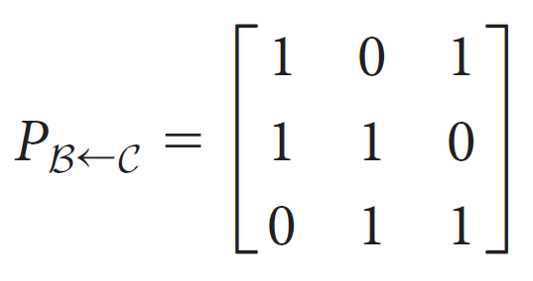


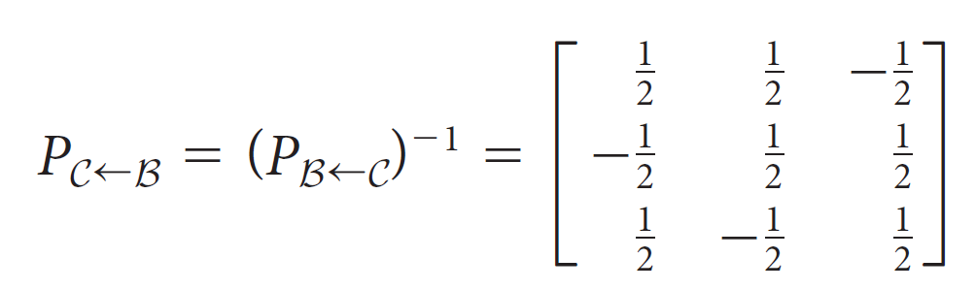
Example 6.46 – Solution (1 of 2)
It follows that
To find
we could express each vector in ℬ as a linear combination of the vectors in C, but it is much easier to use the fact that
by Theorem 6.12(c). We find that

Slide 52
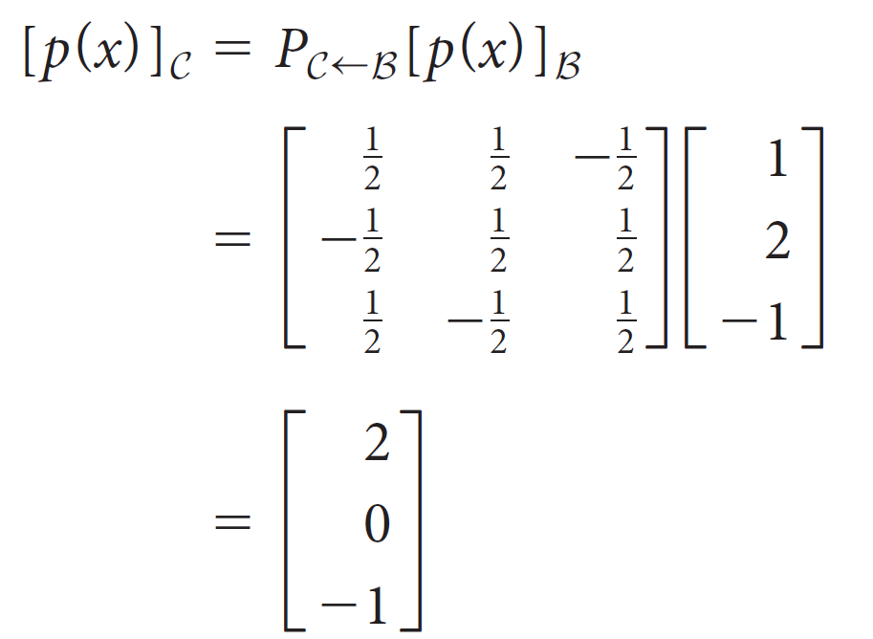
Example 6.46 – Solution (2 of 2)
It now follows that
which agrees with earlier Example.

Slide 53
The Gauss-Jordan Method for Computing a Change-of-Basis Matrix

Slide 54



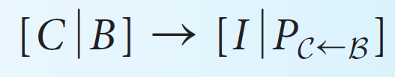
The Gauss-Jordan Method for Computing a Change-of-Basis Matrix (1 of 1)
Theorem 6.13
Let ℬ = {u₁, ..., u_{n}} and
be bases for a vector space V. Let ℬ = [[u₁]_{ℰ} ... [u_{n}] _{ℰ} ] and
where ℰ is any basis for V. Then row reduction applied to the n × 2n augmented matrix
produces

Slide 55

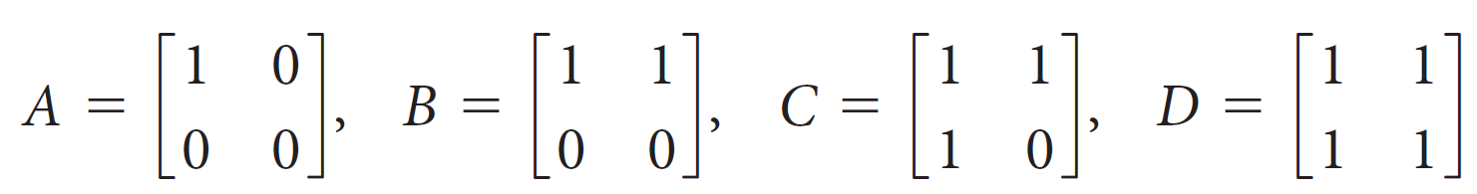
Example 6.48
be the basis {A, B, C, D}, where
In M₂₂, let ℬ be the basis {E₁₁, E₂₁, E₁₂, E₂₂} and let
Solve using the Gauss-Jordan method.
Solution:
Taking ℰ to be the standard basis for M₂₂, we see that

Slide 56
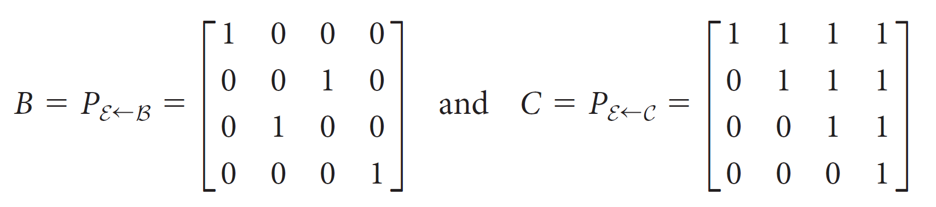
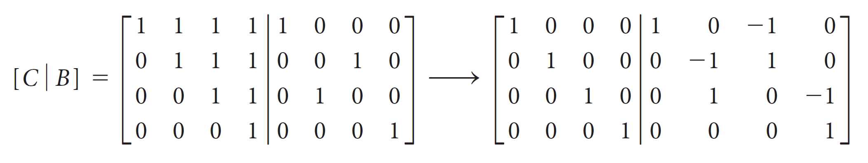
Example 6.48 – Solution (1 of 2)
Row reduction produces

Slide 57
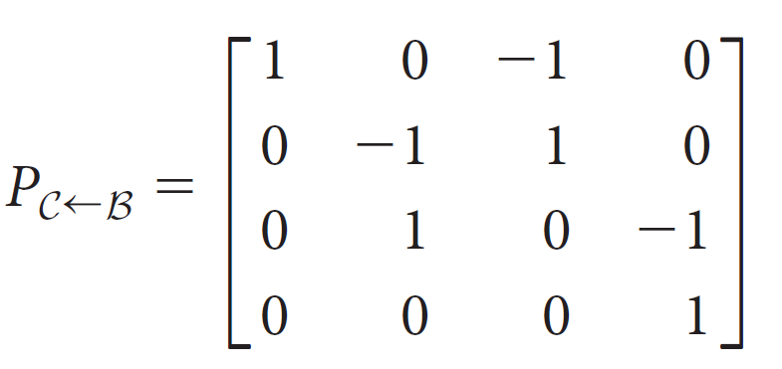
Example 6.48 – Solution (2 of 2)
It follows that
as we found before.

Slide 58
Linear Transformations

Slide 59

Linear Transformations (1 of 1)
Definition
A linear transformation from a vector space V to a vector space W is a mapping
such that, for all u and v in V and for all scalars c,
1. T(u + v) = T(u) + T(v)
2. T(cu) = cT(u)
is a linear transformation if and only if
T(c₁v₁ + c₂v₂ +...+ c_{k}v_{k}) = c₁T(v₁) + c₂T(v₂) +...+ c_{k}T(v_{k})
for all v₁, ..., v_{k} in V and scalars c₁, ..., c_{k}.

Slide 60
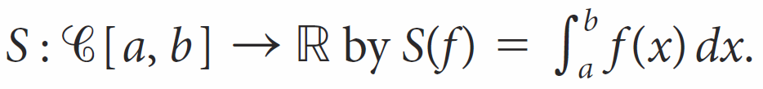

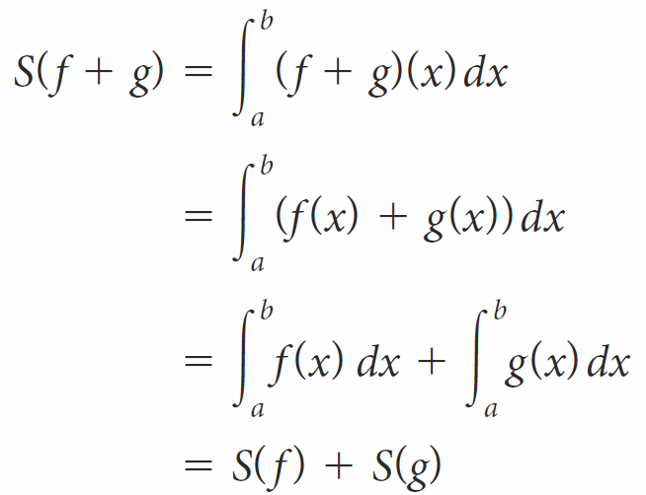
Example 6.52
Show that S is a linear transformation.
Solution:
Define
Let f and g be in
Then

Slide 61
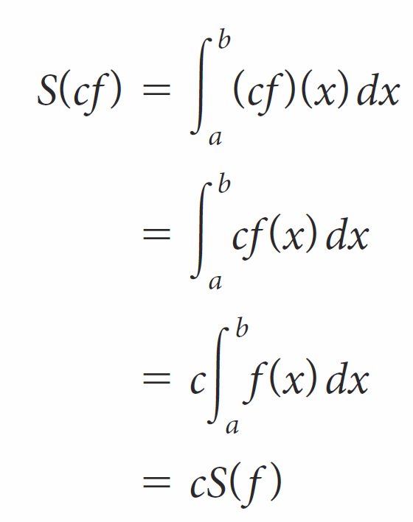
Example 6.52 – Solution
and
It follows that S is linear.

Slide 62
Properties of Linear Transformations

Slide 63
Properties of Linear Transformations (1 of 2)
Theorem 6.14
Let
be a linear transformation. Then:
a. T(0) = 0
b. T(−v) = −T(v) for all v in V.
c. T(u − v) = T(u) − T(v) for all u and v in V.

Slide 64

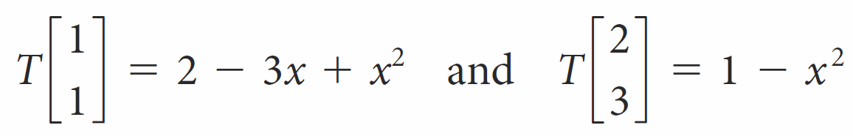
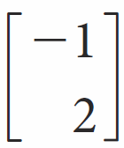
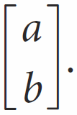
Example 6.55
Suppose T is a linear transformation from
such that
Find T
and T

Slide 65
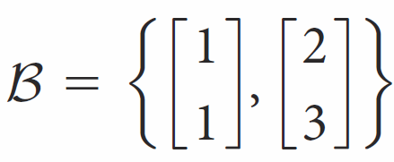

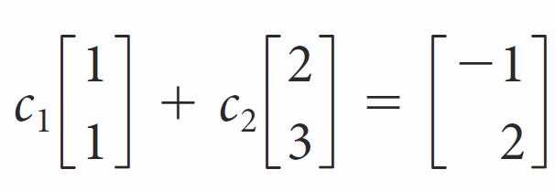
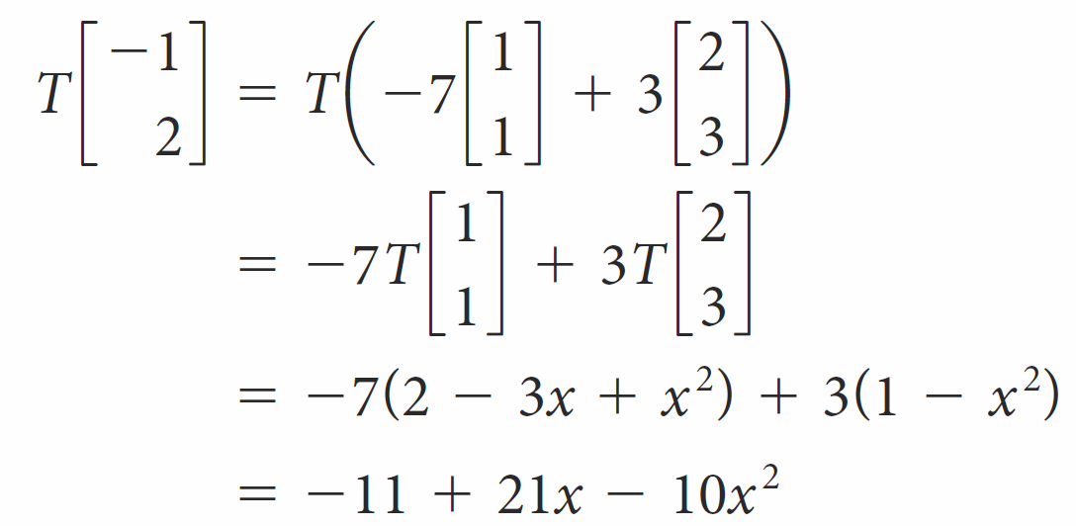
Example 6.55 – Solution (1 of 3)
is a basis for
(why?), every vector in
Since
is in span(B). Solving
we find that c₁ = −7 and c₂ = 3. Therefore,

Slide 66
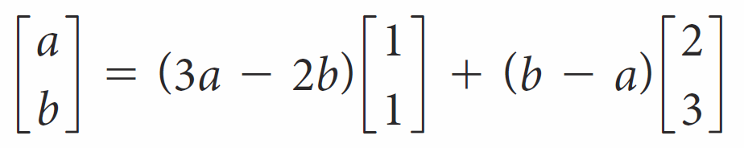
Example 6.55 – Solution (2 of 3)
Similarly, we discover that

Slide 67
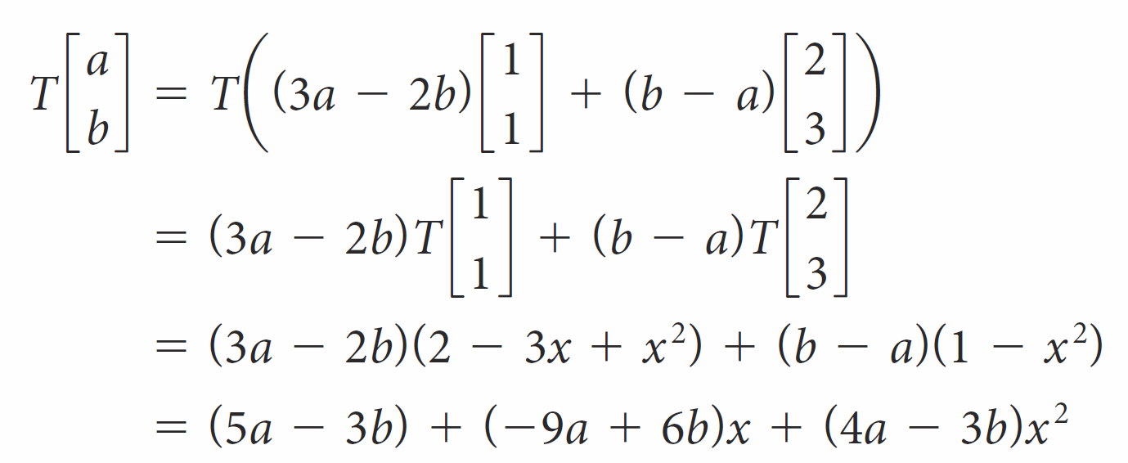
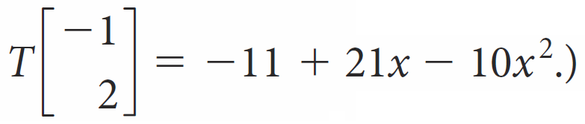
Example 6.55 – Solution (3 of 3)
so
Note that by setting a = −1 and b = 2, we recover the solution

Slide 68
Properties of Linear Transformations (2 of 2)
Theorem 6.15
Let
be a linear transformation and let ℬ = {v₁, ..., v_{n}} be a spanning set for V.
Then T(ℬ) = {T(v)₁, ..., T(v_{n})} spans the range of T.

Slide 69
Composition of Linear Transformations

Slide 70


Composition of Linear Transformations (1 of 2)
Definition
If
are linear transformations, then the composition of S with T is the mapping
defined by
where u is in U.

Slide 71

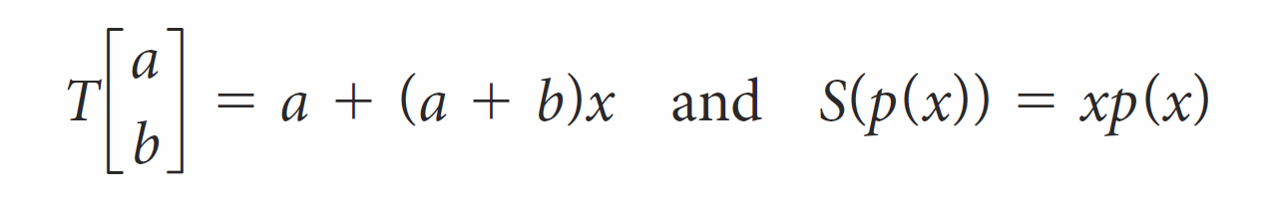
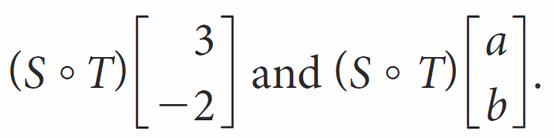
Example 6.56
Let
be the linear transformations defined by
Find

Slide 72
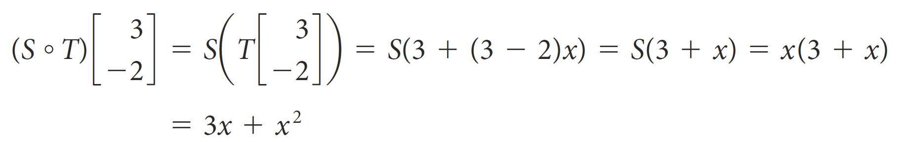
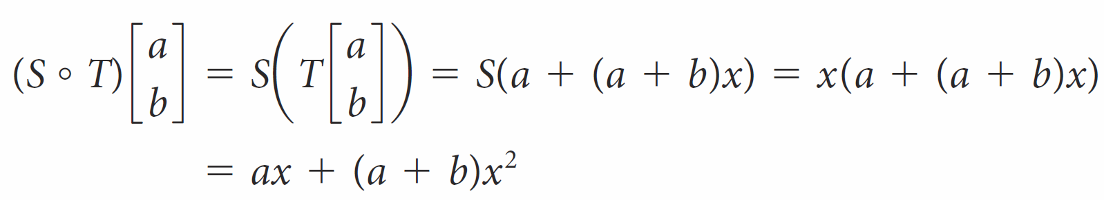
Example 6.56 – Solution
We compute
and

Slide 73

Composition of Linear Transformations (2 of 2)
Theorem 6.16
If
are linear transformations, then
is a linear transformation.

Slide 74
Inverses of Linear Transformations

Slide 75

Inverses of Linear Transformations (1 of 2)
Definition
A linear transformation
is invertible if there is a linear transformation
such that
In this case, T$′$ is called an inverse for T.

Slide 76

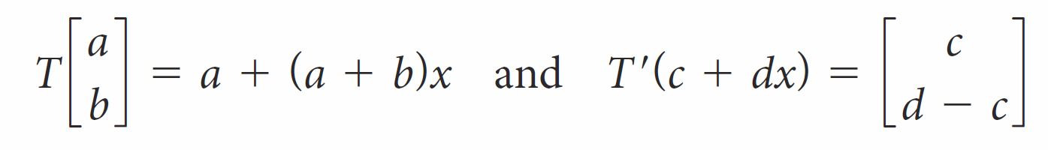
Example 6.58
Verify that the mappings
defined by
are inverses.

Slide 77
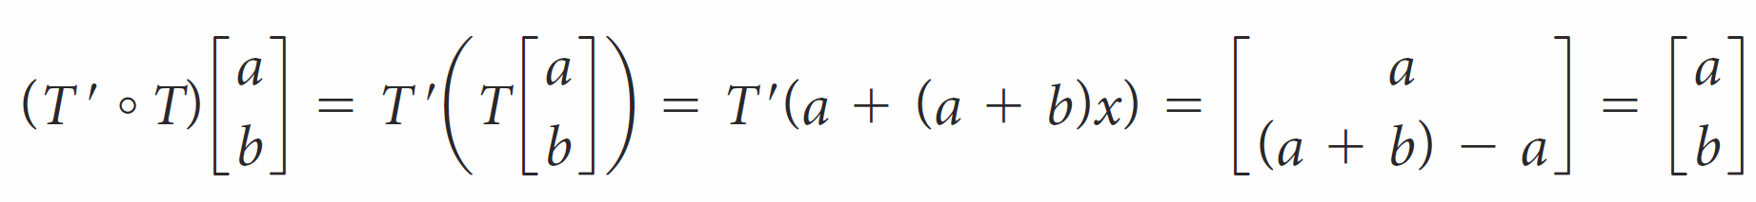

Example 6.58 – Solution
We compute
and
Hence,
Therefore, T and T′ are inverses of each other.

Slide 78
Inverses of Linear Transformations (2 of 2)
Theorem 6.17
If T is an invertible linear transformation, then its inverse is unique.

